Slide 1

GROUP P7016
AUTOMATED SKILL-REVIEWING WEBSITE AND RESUME ANALYZER
UNDER THE GUIDANCE OF DR.K.DHANASREE DEVI MA’AM
MAJOR PROJECT-FINAL REVIEW
01.04.2024

Slide 2
PROBLEM STATEMENT
The traditional resume screening process is time-consuming and manual.
Recruiters often have to screen through hundreds of resumes for a single position.
This can lead to errors and inconsistencies in the screening process.
Job seekers often struggle to tailor their resumes to specific job requirements.

Slide 3
PROCESS WORKFLOW
FRONT END/
BACK END
DJANGO
DATA EXTRACTION
WEBSITE IMPLEMENTATION
SKILL REVIEWS/PERFORMANCE ANALYTICS
PYTHON
REPORT GENERATION

Slide 4
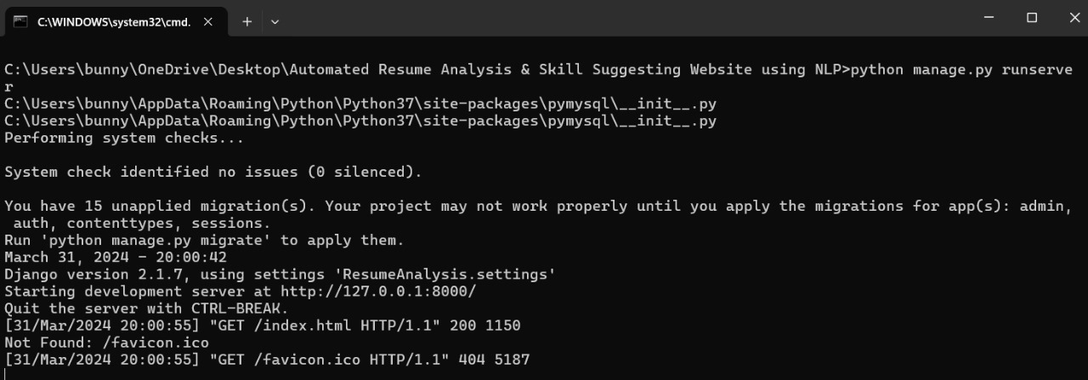
INTERFACES
THE ENTRANCE

Slide 5
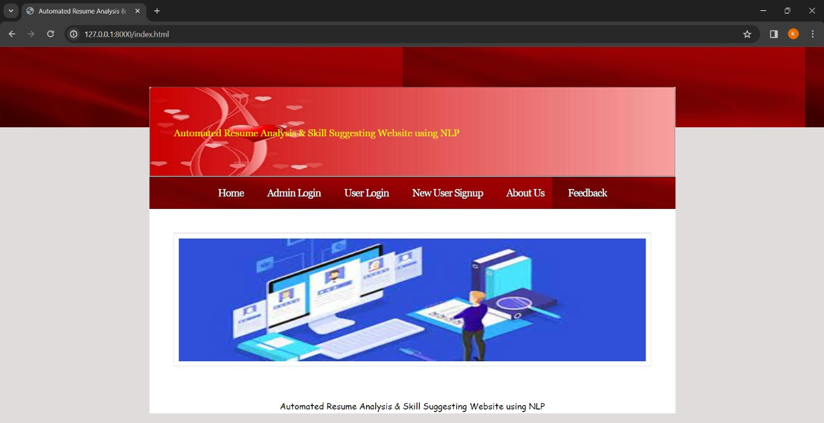
WEBSITE INTERFACES

Slide 6
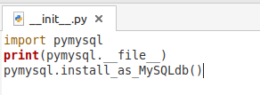
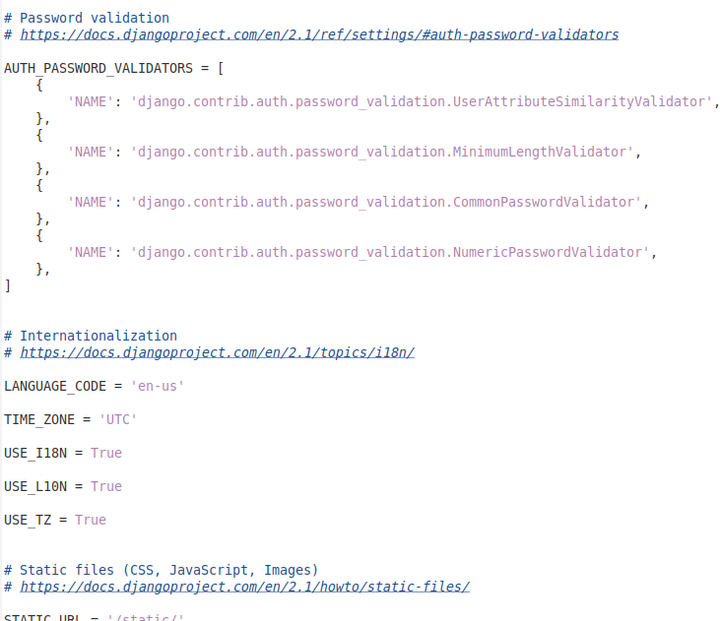
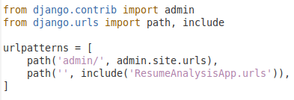
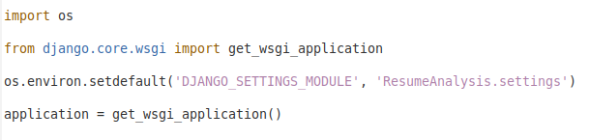
INIT, SETTINGS, URLS & WSGI

Slide 7
INSTALLED_APPS = [
'django.contrib.admin',
'django.contrib.auth',
'django.contrib.contenttypes',
'django.contrib.sessions',
'django.contrib.messages',
'django.contrib.staticfiles',
'ResumeAnalysisApp'
]
MIDDLEWARE = [
'django.middleware.security.SecurityMiddleware',
'django.contrib.sessions.middleware.SessionMiddleware',
'django.middleware.common.CommonMiddleware',
'django.middleware.csrf.CsrfViewMiddleware',
'django.contrib.auth.middleware.AuthenticationMiddleware',
'django.contrib.messages.middleware.MessageMiddleware',
'django.middleware.clickjacking.XFrameOptionsMiddleware',
]
The INSTALLED_APPS setting in Django's settings.py file lists the installed applications, including Django's default components like admin, authentication, sessions, messages, and static files, as well as custom apps like 'ResumeAnalysisApp'. The MIDDLEWARE setting specifies the order and functionality of middleware components that process requests and responses, such as security, session management, authentication, CSRF protection, and message handling.

Slide 8
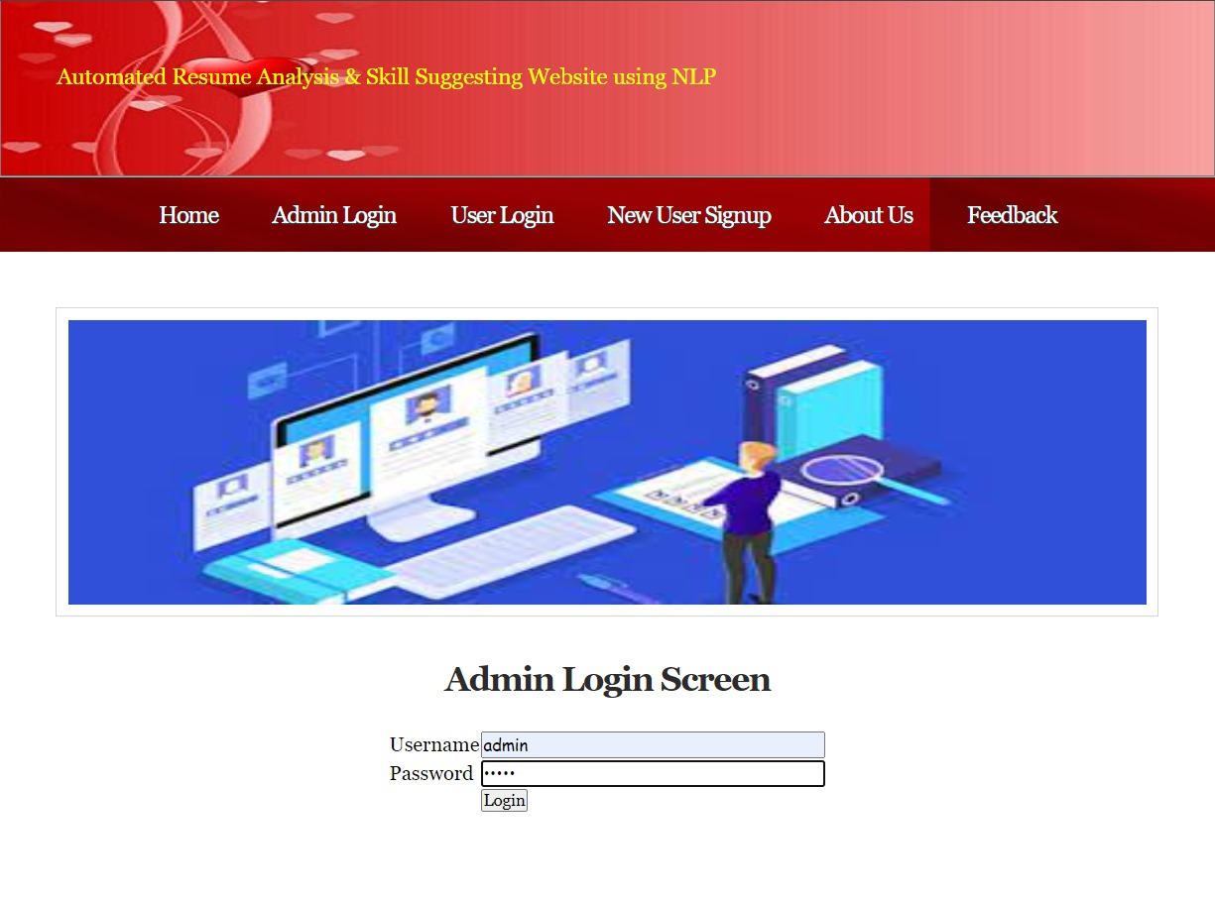
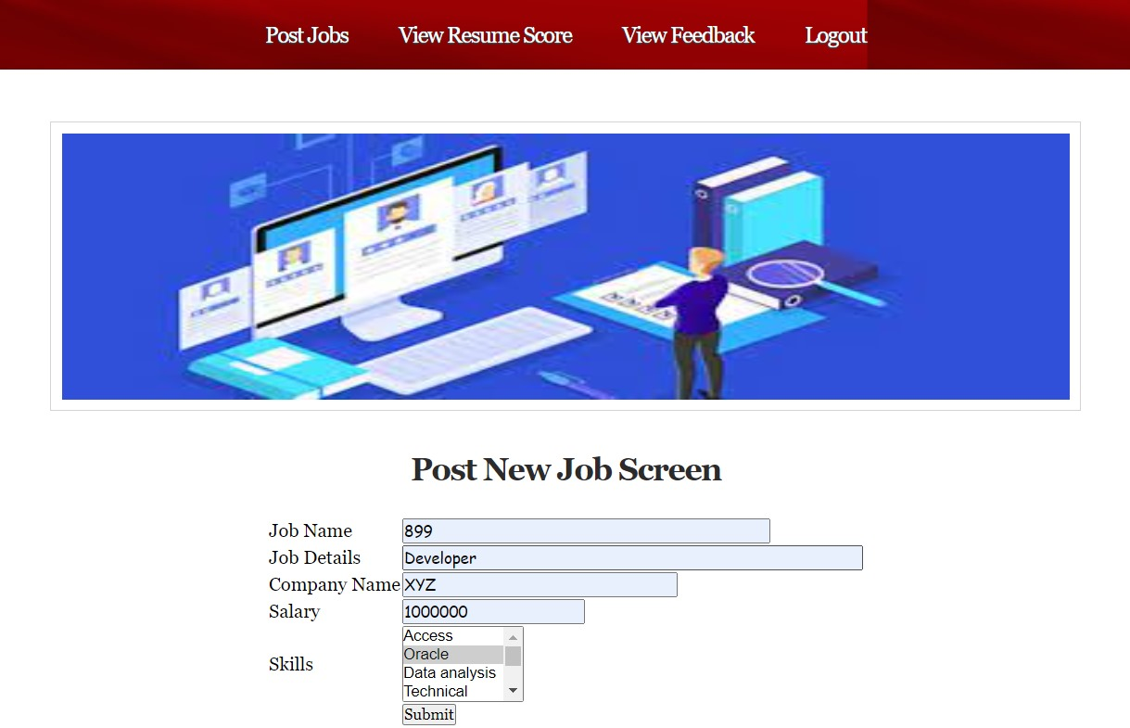
REST INTERFACES

Slide 9
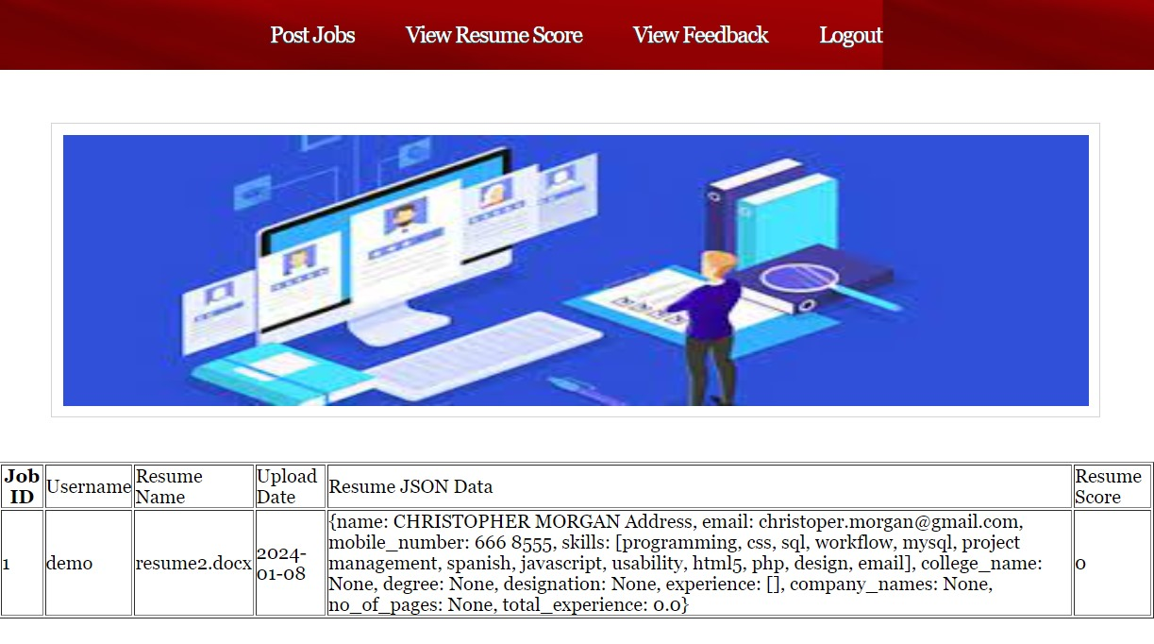
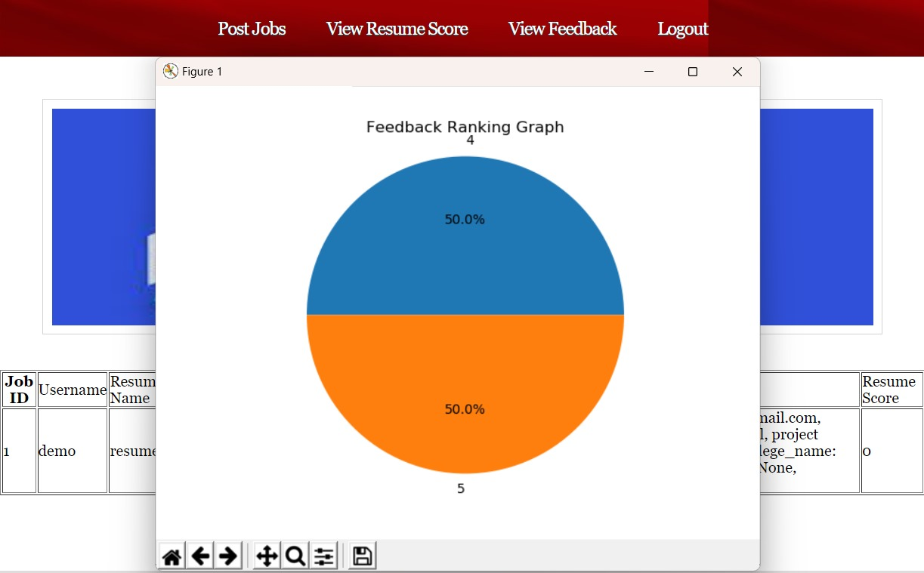

Slide 10
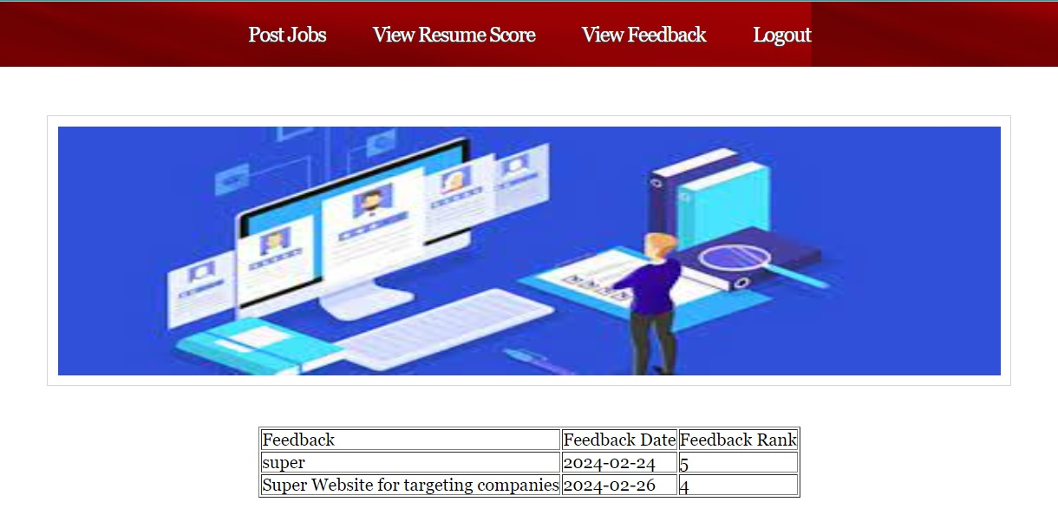
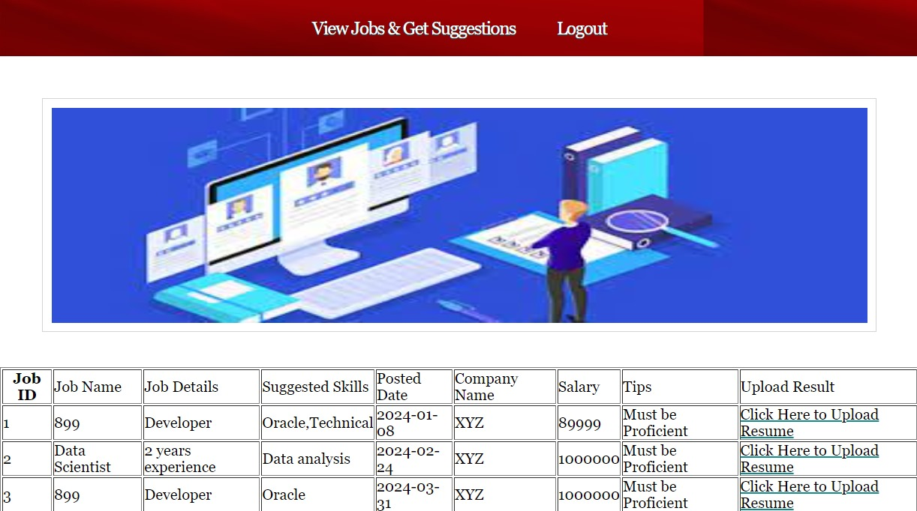
USER LOGIN AND FEEDBACK

Slide 11
#getScore code
def getScore(job_id, skills):
require_skills = None
score = 0
con = pymysql.connect(host='127.0.0.1',port = 3306,user = 'root', password = 'root', database = 'resumeanalysis',charset='utf8')
with con:
cur = con.cursor()
cur.execute("select skills FROM postjob where job_id='"+job_id+"'")
rows = cur.fetchall()
for row in rows:
require_skills = row[0]
require_skills = require_skills.strip().split(",")
for i in range(len(skills)):
skills[i] = skills[i].lower().strip()
for i in range(len(require_skills)):
require_skills[i] = require_skills[i].lower()
print(require_skills)
found_skills = [x for x in skills if x in require_skills]
if len(found_skills) > 0:
if len(found_skills) >= len(require_skills):
score = 100
else:
score = len(found_skills) / len(require_skills)
score = score * 100
return score
This Python function, getScore, calculates a score based on matching skills between a job requirement and a list of skills provided as input.
It establishes a connection to a MySQL database named 'resumeanalysis' using pymysql.
It retrieves the required skills for a job from the 'postjob' table in the database based on the job_id parameter.
It processes the retrieved require_skills by splitting them into a list and converting them to lowercase.
It processes the input skills list by converting all elements to lowercase and stripping any whitespace.
It finds the common skills between skills and require_skills.
It calculates the score based on the number of common skills found:
If all required skills are present, it assigns a score of 100.
If only some required skills are present, it calculates the score as the ratio of found skills to required skills and scales it to a percentage.
It returns the calculated score.
Note: The code directly accesses the database using raw SQL queries, which can be a security risk and may not follow best practices such as using Django's ORM for database operations and parameterized queries to prevent SQL injection attacks.

Slide 12
THANK YOU
To our esteemed guide,
DR.K.DHANASREE DEVI MA’AM
To the panel,
DR. M. AKKALAKSHMI MA’AM
DR. RIYAZUDDIN Y MD SIR
DR. DEEPAK N BIRADAR SIR
DR. T. VIJAYA SARADHI SIR(SPOC)

